Slide 1
Note: Distributed System Design, Integration, SOA, EDA, and Architecture Stuff
Harry Chou
Enterprise Software Development with Passion
www.harrychou.com

Slide 2
Sources
Mostly, Udi Dahan’s “Advanced Distributed Systems Design with Service Oriented Architecture” class
Stuff from other Places

Slide 3
Distributed Systems
What is Distributed System Design? Why is it important?
Why ‘Distributed Systems’ are different? Why ignoring the differences will cause major problem?
With the ‘differences’ in mind? What are the principles one can use to design Distributed Systems?

Slide 4
Systems are not applications
Application
an application has a single executable and runs on a single machine
usually have one source of data
usually don’t have to work with other applications
don‘t have to worry about connectivity issues

Slide 5
System Collaboration Issues
network availability
can I get to the person?
can the person get back to me?
what should we do when the communication channel is not available?
network performance
can I and the person get to each other in reasonable timeframe?
what is the ‘reasonable timeframe’?
if we know there will be a delay, what should we do while we are waiting?
system availability
what if the person is dead?
what if I am dead?
system performance
what if one of us is injured and take a really long time to respond?
system interoperability
how can we understand each other?
transactional consistency
what if one of us fails to perform one’s duty?
what if the person lied or misled?
what if the person gives conflicting information?
security (don’t give out secure data, don’t take order from bad guys)

Slide 6
“Distributed” Systems
Physically and Logically Centralized
Physically Centralized, yet Logically Distributed
multiple layers on the same server
using in-memory, cross-appdomain/process communication
Logically Centralized, yet Physically Distributed
clustering, distributed computing
Physically and Logically Distributed

Slide 7
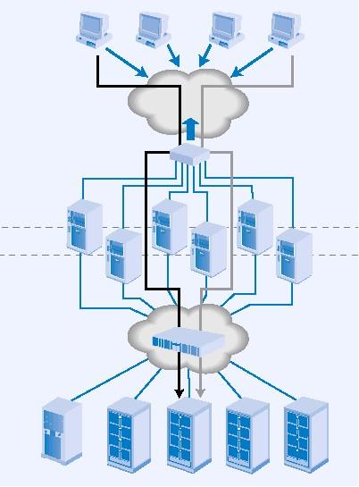

Systems are not applications
A system can be made up of multiple executable elements on multiple machines
Usually has multiple sources of information
System must deal with “connectivity”

Slide 8
Systems are not applications
Each executable within a system is not an application
Each executable must deal with “connectivity”

Slide 9
“Connectivity” – the network matters
Common assumptions made by developers and architects in distributed systems
The network is reliable
Latency isn’t a problem
Bandwidth isn’t a problem
The network is secure
The topology won’t change
The administrator will know what to do
Transport cost isn’t a problem
The network is homogeneous
Deutsch 94
Gosling 97

Slide 10
“Connectivity” – the network matters
“The 8 fallacies of distributed computing”
The network is reliable
Latency isn’t a problem
Bandwidth isn’t a problem
The network is secure
The topology won’t change
The administrator will know what to do
Transport cost isn’t a problem
The network is homogeneous
Deutsch 94
Gosling 97

Slide 11
3 More Fallacies
The network is reliable
Latency isn’t a problem
Bandwidth isn’t a problem
The network is secure
The topology won’t change
The administrator will know what to do
Transport cost isn’t a problem
The network is homogeneous
The system is atomic/monolithic
The system is finished
Business logic can and should be centralized
Neward 06

Slide 12
#1. The network is reliable
Reasons thing fail
Switch goes up in smoke
Power out
Someone trips over the network cord
New/Different security settings (Firewalls, XP SP2)
Various hardware/software failures
This means:
Messages/Data can get lost when sent over the wire
What do you do when that happens?
What if you don’t even know when it happens?

Slide 13
#1. The network is reliable
Solutions:
Use reliable messaging infrastructure
MSMQ
Sql Server 2005 Service Broker
Roll your own
Ack & Retry
Store & Forward

Slide 14
#2. Latency isn’t a problem (==0)
Latency is the time it takes a single call to cross the network
Reasonably small for a LAN, not so small for a WAN, and significant over the internet
~ 1000 times slower than in-memory access
If a remote object has 10 properties and you access them one by one, you pay 10 round-trips crossing the network 20 times

Slide 15
#2. Latency isn’t a problem (==0)
Solutions:
Don’t cross the network if you don’t have to
Inter-object chit-chat shouldn’t cross the network
If you have to cross the network,
take all the data you might need with you

Slide 16
#3. Bandwidth isn’t a problem ( )
Although bandwidth keeps growing, the amount of data grows faster
When transferring lots of data in a given period of time, network congestion may interfere

Slide 17
#3. Bandwidth isn’t a problem ( )
Solution:
Move time-critical data to separate networks

Slide 18
#4. The Network is Secure
Unless you’re on a separate network that will never, ever be connected to anything else…
Well, not even then. Viruses, Trojans, etc can still be brought in by users on CDs, DVDs, DOKs, etc
You can’t be 100% safe from everything

Slide 19
#4. The Network is Secure
Solution:
Perform a threat model analysis
Balance costs against risks
Most importantly, think about it.

Slide 20
#5. The Topology won’t change
Unless a server goes down and is replaced
Or is moved to a different subnet
Or clients wirelessly connect and disconnect
What will happen to the application when those hard coded / config-file values change?

Slide 21
#5. The Topology won’t change
Solution:
Don’t hard-code IP address
Use resilient protocols (multicast)
Use discovery
Will your system be able to maintain response-time requirements when this happens?

Slide 22
#6. The admin will know what to do
Possible in small networks
Unless he gets run over by a truck. His replacement probably won’t know what to do.
If there are multiple admins, rolling out various upgrades and patches, will everything grind to a halt?
Will client software be able to work with a new version of the server?

Slide 23
#6. The admin will know what to do
Solution:
Consider how to pinpoint problems in deployment scenarios
Consider multiple versions running in multiple locations concurrently
Enable the admin to take parts of the system down for maintenance without adversely affecting the rest

Slide 24
#7. Transport cost isn’t a problem
Serialization before crossing the network (and deserialization on the other side) takes time.
The hardware network infrastructure has upfront and ongoing costs.

Slide 25
#7. Transport cost isn’t a problem
Solution:
The effect of serialization on performance further strengthen the argument to stay away from chatting over the network
Architects need to make trade-offs between infrastructure costs and development costs – upfront vs. ongoing.

Slide 26
#8. The network is homogeneous
Well, it just isn’t.
Interoperability matters
Try to stay away from proprietary protocols
Semantic interoperability will always be hard, budget for it

Slide 27
#9. The system is atomic
By viewing the system as an indivisible whole, maintenance can become a nightmare
Changing one part of the system affects other parts
If the system wasn’t designed to scale out to multiple machines, doing so may actually hurt performance
You’d be surprised what other applications are using your DB. What’ll happen to them when you change the schema?

Slide 28
#9. The system is atomic
Solution:
Internal loose coupling
Modularize
Design for scale out in advance, or you just may end up being stuck with scale up.
Design for interaction with other software. It will happen.

Slide 29
#10. The system is finished
Maintenance costs over the lifetime of a system are greater than its development costs
The system is never “finished”
How will you upgrade the system while it’s in production? What about just parts of it?

Slide 30
#10. The system is finished
Solution:
Design for maintenance. Up front developer productivity matters less.
Design for upgrades. “Click Once” doesn’t count.
Versioning is hard even at the conceptual level. Don’t expect technology to solve it for you.

Slide 31
#11. Business Logic can and should be centralized
“First name will be less than 40 characters”
Enforce in the UI? Business logic layer? Database? Everywhere?
When the business rules change, how will you know what parts of the system to change?

Slide 32
#11. Business Logic can and should be centralized
Solution:
Accept that business logic and validation will be distributed. Plan for it.
At design time, package rules enforcement together. For example, a single solution with projects for validation for the UI, BLL, and the DB.

Slide 33
A final word on transactions
Distributed transactions that synchronously lock resources across multiple machines perform poorly.
Faster hardware means systems will just spend more cycles waiting.

Slide 34
Summary
Best practices have yet to catch up to
“best thinking”
Technology cannot solve all problems
Adding hardware doesn’t necessarily help

Slide 35




Coupling in Distributed Systems
Udi Dahan – The Software Simplist
Enterprise Development Expert & SOA Specialist
Consulting, Mentoring, & Training
Helping you Keep It Simple
www.UdiDahan.com
email@UdiDahan.com

Slide 36
What is coupling?
A measure of dependencies
If X depends on Y, there is coupling between them
2 kinds of coupling: Afferent (Ca), Efferent (Ce)

Slide 37
What is coupling?
Afferent coupling (Ca) – who depends on you
Efferent coupling (Ce) – on who you depend

Slide 38
What is coupling?
If X depends on Y then:
X is efferently coupled to Y
Y is afferently coupled to X

Slide 39
Coupling at the systems level
Ce: The number of classes in system X that depend on something belonging to system Y
Ca: The number of classes in system Y that something in an external systems depends on

Slide 40
Coupling at the systems level
Ce: The number of classes in system X that depend on something belonging to system Y
If Y changes in some way, how many changes do we have to make in X?
Ca: The number of classes in system Y that something in an external systems depends on
In what ways can we change Y safely?

Slide 41
Loose Coupling at the systems level
Attempt to minimize afferent and efferent coupling
Zero coupling isn’t really possible
3 Different aspects of coupling for systems:
Platform
Temporal
Spatial

Slide 42
Coupling Aspect #1: Platform
Also known as “Interoperability”
Using protocols only available on one platform
Remoting
Enterprise Services
Datasets over Web Services
One of the 4 Tenets of Service Orientation:
“Share contract and schema, not class or type”

Slide 43
Coupling Aspect #2: Temporal
Service A
Service B
Synchronous Call
Waiting
Working
Return
Processing time of Service B affects that of A

Slide 44
Coupling Aspect #3: Spatial
Service B
Service A

Slide 45
Coupling Aspect #3: Spatial
Service B
Service A

Slide 46
Coupling Aspect #3: Spatial
Service B
Service A
?
Service B
Can communication automatically continue?

Slide 47
Coupling Aspects: Solutions

Slide 48
Coupling Aspect #1: Platform
XML on the wire.
XSD (schema) describing XML structure
Use standards based transfer protocol like http
Standards based description of message flow
WSDL (only supports request/response)
SSDL (supports richer semantics)

Slide 49
Coupling Aspect #2: Temporal - 1
Bad. Resources are held while waiting.

Slide 50
Coupling Aspect #2: Temporal - 2
Resources are held while waiting. Increased load on service B per consumer (impacted by polling interval)

Slide 51
Coupling Aspect #2: Temporal - final
Good. By separating (in time) the inter-service communication and the request handling

Slide 52
Pub/Sub Temporal Constraints
Subscriber must be able to make decisions based on somewhat stale data
Requires a strong division of responsibility between publishers and subscribers
Only one logical publisher should be able to publish a given kind of event

Slide 53
Coupling Aspect #3: Spatial
Application level code should not need to know where cooperating services are on the network
Delegate communications to “something else”, let’s call it an “agent” for now.
myAgent.Send(message);
How does the agent know which destination to send the message to?

Slide 54
Load Balancing
Clients talking to servers through a load balancer don’t know which physical server is handling the request…
… as long as logically the server CAN handle the request
Routing is first logical, and second physical

Slide 55
Coupling Aspect #3: Spatial
But if the application code doesn’t tell the agent which logical destination to send the message to, how would the agent know?
If there was a direct mapping from message type to logical destination, then specifying the type of message being sent/published would be enough

Slide 56
Message Type = Logical Destination
AddCustomerMessage:
Sent by clients to one logical server
Multiple physical servers behind a load balancer
OrderCancelledEventMessage:
Published by one logical server
Multiple physical servers can publish the same
Strongly-typed messages simplify routing

Slide 57
Summary
Loose coupling is more than just a slogan
Coupling is a function of 5 different dimensions
Platform
Temporal
Spatial
Afferent
Efferent

Slide 58
Messaging Patterns
Udi Dahan – The Software Simplist
.NET Development Expert & SOA Specialist
Consulting, Mentoring, & Training
Helping you Keep It Simple
www.UdiDahan.com
email@UdiDahan.com

Slide 59
Why Messaging?
Reduces coupling
Use XML for platform coupling
Use asynchronous messaging for temporal coupling
Reduces afferent and efferent coupling while increasing autonomy

Slide 60
Performance – RPC vs Messaging
Throughput
Messaging
RPC
Load
With RPC, threads are allocated with load
With messaging, threads are independent
Difference based on blocking nature of comms.
Memory, DB locks, held longer with RPC

Slide 61
Messaging, Coupling, & Autonomy
Schema A
Schema B
Service A
Service B
Communications
Service A and B don’t directly depend on each other

Slide 62
Asynchronous Messaging
It’s all about one-way, fire & forget messages
Everything is built on top of it
Return Address pattern
Correlated Request/Response
Publish/Subscribe

Slide 63
One-way, fire & forget messaging
Initiating Service
Target Service
Sends, and keeps on working
Id
Each message has an Id.
Seems simple, but there’s more to it.

Slide 64
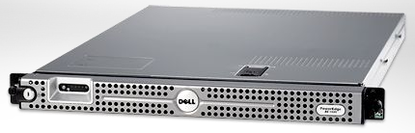

Server
MSMQ
Outgoing Incoming
Store and Forward
adds resilience
MSMQ
Outgoing Incoming
Client

Slide 65
Standard message handling
Customer Service
void Change_Address(Guid id, Address a);
void Make_Preferred(Guid id);
void Change_Credit(Guid id, Credit c);
Problem is that service layers get too large
Difficult for multiple developers to collaborate
Difficult to reuse logging, authorization, etc

Slide 66
Exploit strongly-typed messages
IMessage
where T : IMessage
IHandleMessages<T>
void Handle(T message);

Slide 67
Represent methods as messages
IMessage
Change_Address_Msg
Make_Preferred_Msg
Change_Credit_Msg

Slide 68
Handling Logic Separated
IHandleMessages<T>
void Handle(T message);
H1:
IHandleMessages<Change_Address_Msg>
H2:
IHandleMessages<Make_Preferred_Msg>
H3:
IHandleMessages<Change_Credit_Msg>

Slide 69
Multiple handlers per message
H1:
IHandleMessages<Change_Address_Msg>
H4:
IHandleMessages<Change_Address_Msgv2>
Authorization:
IHandleMessages<IMessage>
Dispatch based on type polymorphism
Allows for pipeline of handler invocation

Slide 70
Fault-tolerance - scenarios
When servers crash
When databases are down
When deadlocks occur in the database

Slide 71


When Servers Crash
[HTTP] $$ Order
DB
App
Tx
Call 1 of 3
Call 2 of 3
Critical Windows Patch
Rollback
Where’s the order!?
Notes:
The DB is consistent - but the order isn’t there.
When the App comes back up again, the order isn’t in memory, or on the network stack.
Are you hoping the user will click “submit” again? Or that the external system will resubmit?
That’s OK - these days you don’t get a critical patch more than once every 2-3 days.
Also, consider what happens if the DB is down. The App gets some kind of exception, it writes it to the log, and moves on. At least we know that the reason that the order disappeared is logged.

Slide 72
When Databases Are Down
[HTTP] $$ Order
Call 1 of 3
DB
App
Tx
Exception
Write to log
Down
Where’s the order!?
Notes:
At least we know that the reason that the order disappeared is logged.

Slide 73

When Deadlocks Happen
[HTTP] $$ Order
DB
App
Tx
Call 1 of 3
Call 2 of 3
Exception
Write to log
A
B
Where’s the order!?
Deadlock
Notes:
Deadlocks happen all the time in production databases - just ask your DBA.
By the way, the only thing to do is usually to retry (up to a point). Of course, you’re susceptible to restarts during those retries.

Slide 74
How Does Messaging Help?
Rollback
Tx
$$ Order
Q
Receive
Rollback
App
Call 1 of 3
DB
Call 2 of 3
The order is back in the queue
Notes:
Actually, in order to support this scenario, in-memory messaging isn’t enough - we need durable messaging. In the other cases where the DB is down or there’s a deadlock will work fine for in-memory messaging.

Slide 75

Calling Web Services
Rollback
$$ Order
A
B
C
D
Not Rolled back
[HTTP] Invoke
DB
WS
Deadlock

Slide 76
Web Services with Messaging
The message won’t be sent if there’s a failure
$$ Order
A
B
C
D
Msg
[HTTP] Invoke
Messaging
Gateway
DB
WS

Slide 77
Return Address Pattern
Initiating Service
Target Service
Return Address
Return Address
Some time in the future
2 Channels: one for requests, one for responses

Slide 78
Importance of Return Address
Service A
Server 1
Service B
Server 2
Service A
Server 3
Request 0
Request 1
Response 1
Enables distributing load between servers in the same service, creating a message handling pipeline

Slide 79
Correlated Request/Response
Based on Return Address
Initiating Service
Target Service
Ticket (guid)
Some time in the future
Ticket (guid)
In the header of the response message, there is a correlation id equal to the request message id

Slide 80
Correlated Response API
When the response arrives, how can we pass it back to the object that initiated the request?
If the object would pass a callback along with the message it wanted to send…
void Send(IMessage msg).Register(
AsyncCallback cb, object state);
Callbacks don’t survive restarts.

Slide 81
Server
MSMQ
Outgoing Incoming
MSMQ
Outgoing Incoming
Client

Slide 82
Publish / Subscribe
Basis for “events” between systems
What is an event in messaging?
The receipt of a message
So, publishing an event means just sending a message to numerous destinations.

Slide 83
Out-of-order events
Order Accepted
Sales
Billing
Order Accepted
Order Billed
Now waits for OrderBilled
which won’t arrive again
Shipping
Can’t find order in DB
Throws away the message

Slide 84
Out-of-order messaging
Assume that messages may arrive out of order
Consider retrying messages later in those cases
Benefits include:
Increased parallelism
Better fault-tolerance

Slide 85
Publish / Subscribe
But what does “subscribe” mean?

Slide 86
Subscribe
In order to avoid spatial coupling, we have a mapping between message type & destination
If we have subscribed to a message type, then we have a handler for it
Therefore, registering that handler with the communications infrastructure is enough to express “subscribe”
The infrastructure will send its own subscribe message

Slide 87
Subscribe
When the communications infrastructure receives a “subscribe” message, it saves the return address.

Slide 88
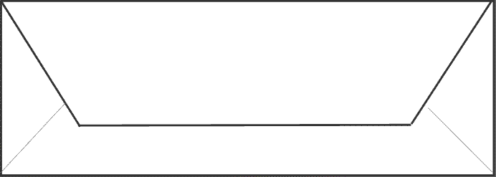
Subscriber
Publisher
Subscribe
Subscriber
Subscriber
Subscriber
Subscriber

Slide 89
Subscriber
Publisher
abcdefgh
Subscriber
abcdefgh
Subscriber
abcdefgh
Subscriber
abcdefgh
abcdefgh
Subscriber

Slide 90
Summary
Using the building blocks:
IMessage
IHandleMessages
Send, Reply, and Publish
We can achieve loosely coupled communication between services.

Slide 91
Architectural Styles Bus & Broker
Udi Dahan – The Software Simplist
Enterprise Development Expert & SOA Specialist
Consulting, Mentoring, & Training
Helping you Keep It Simple
www.UdiDahan.com
email@UdiDahan.com

Slide 92
What is an “Architectural Style”?
An architectural style is a coordinated set of architectural constraints that restricts the roles/features of architectural elements and the allowed relationships among those elements within any architecture that conforms to that style.
Fielding 2000

Slide 93
What is an “Architectural Style”?
In plain English:
What is and isn’t allowed in an architecture, but not detailed enough to be an architecture itself

Slide 94
SOA as an Architectural Style
SOA is founded on messaging
It is best to first understand current styles also founded on messaging before going to SOA

Slide 95
Bus & Broker Commonalities
Attempt to handle spatial coupling

Slide 96
Broker Architectural Style
Initiator requests a service from the broker
Broker performs per request or per connection routing
Service B
Service A
Broker
Service C
Service D

Slide 97
Broker Characteristics
Broker is physically separate
All communication goes through the broker
Broker handles fail over, routing
The broker is a single point of failure, must be robust and performant.

Slide 98
Broker Technology
BizTalk
CORBA
UDDI

Slide 99
Broker Advantages
By concentrating all communications to a single logical entity, it can be centrally managed
Enables “intelligent” routing, data transformation, orchestration
Doesn’t require changes to surrounding apps

Slide 100
Broker Disadvantages
Embodies the 11th fallacy:
“Business logic can and should be centralized”
Violates autonomy of the services

Slide 101
Bus Architectural Style
Event sources and sinks communicate via channels in the bus
Source place events (messages) in channels, sinks are notified about message availability
Source
Sink
Bus
Sink
Source

Slide 102
Bus Topology
App
App
Bus.dll
Bus.dll
App
App
Bus.dll
Bus.dll
App
App
Bus.dll
Bus.dll
App
App
Bus.dll
Bus.dll

Slide 103
Bus Characteristics
Bus is not necessarily physically separate
Channels are both physical and logical
Communication is dispersed over multiple channels
Bus is simpler – no routing or service fail over
No single point of failure

Slide 104
Bus Technology
“New” Enterprise Service Bus (ESB) products
“Old” JMS implementations
Tibco Rendezvous
IBM MQ
MS Sql 2005 Service Broker
MSMQ – least powerful of the above

Slide 105
Bus Advantages
No single point of failure
Doesn’t break service autonomy
The “anti-broker”

Slide 106
Bus Disadvantages
More difficult to design distributed solutions than centralist ones

Slide 107
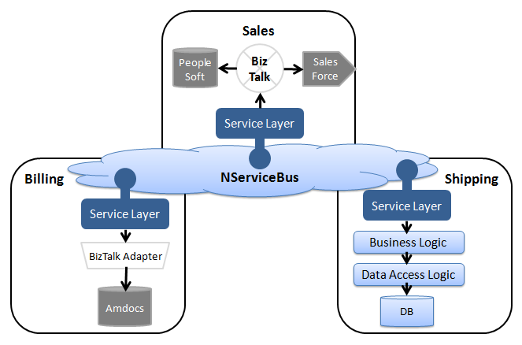
The best of both worlds

Slide 108
Summary
Feature-rich broker products less suited to distributed systems than robust bus products.
SOA Architectural Style most likely to be based on the Bus Architectural Style.

Slide 109
SOA Building Blocks
Udi Dahan – The Software Simplist
Enterprise Development Expert & SOA Specialist
Consulting, Mentoring, & Training
Helping you Keep It Simple
www.UdiDahan.com
email@UdiDahan.com

Slide 110
What is a service?
4 Tenets of Service Orientation:
1. Services are autonomous.
2. Services have explicit boundaries
3. Services share contract & schema,
not class or type
4. Service interaction is controlled by policy.

Slide 111
What is a service?
A service is the technical authority for a specific business capability.
All data and business rules reside within the service.

Slide 112
What a service is NOT
A service that has only functionality is a function,
not a service.
Like check if order is valid
A service that has only data is a database,
not a service.
Like [create, read, update, delete] entity

Slide 113

Service Examples
Place Order
Sales
Save status locally
Save pricing locally
Subscribe to Product Pricing Updated
Subscribe to Customer Status Updated
Publish
Product Pricing Updated
Publish
Customer Status Updated
Customer Care
Marketing
Publish Order Accepted

Slide 114
Service Event Lifecycles
Cascading events give rise to business processes
Inventory Replenished
Price Changed
Order Shipped
Order Received
Customer Billed

Slide 115
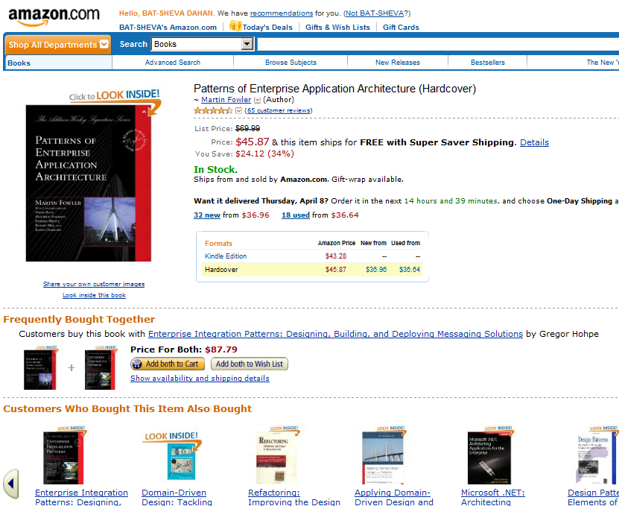
Which service owns this page?

Slide 116
Which service owns this page?
None

Slide 117
Service Deployments
Many services can be deployed to the same box
Many services can be deployed in the same app
Many services can cooperate in a workflow
Many services can be mashed up
in the same page

Slide 118
Same page composition
Server
Product Catalog
Pricing
Inventory
Cross Sell

Slide 119
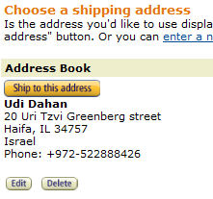
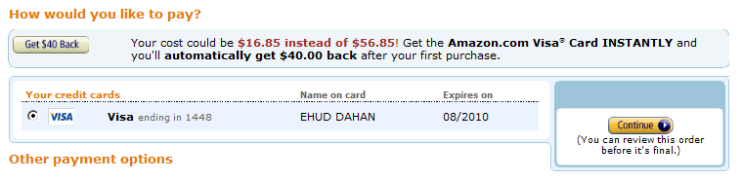
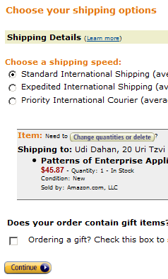
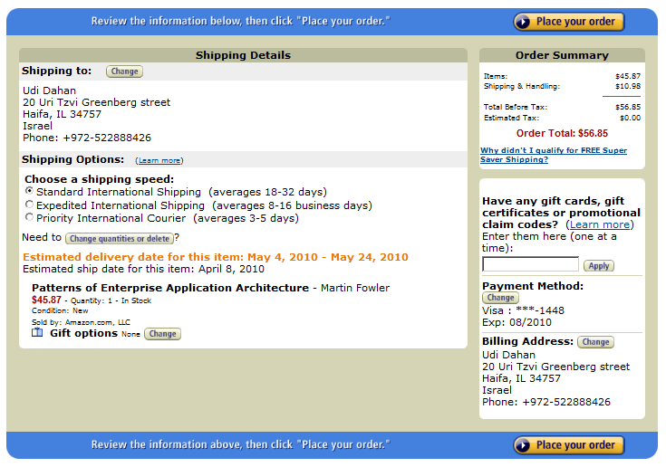
Amazon.com checkout workflow

Slide 120
Which service owns this flow?

Slide 121
Which service owns this flow?
None

Slide 122
Workflow composition
Billing
Shipping
Sales
Shipping
Billing
Sales

Slide 123
Technical properties of a service
A service may have multiple end points
A service may communicate over multiple protocols and transports
A service is responsible for its own availability and scalability

Slide 124
Availability Challenges
If a subscriber goes down, messages are buffered (written to disk) at the publisher
While this store-and-forward behavior allows subscribers to restart without losing messages…
… this leads to additional storage requirements for the publisher:
Rate of messages x Message size x Time
1K msg/s x 1 MB / msg x 5 minutes = 300 GB

Slide 125
Availability Impacts
If a publishing machine runs out of disk space, it will crash
Unavailable subscribers may cause a publisher to become unavailable…
… unless the publisher starts discarding messages after a certain period of time
TimeToBeReceived attribute in NServiceBus

Slide 126
Subscriber Challenges
Now a subscriber may end up missing messages if it is unavailable
Reliable messaging was supposed to solve this
A mitigating characteristic in the problem guides us to the solution:
If the subscriber can’t be bothered to be online enough of the time, maybe it doesn’t need an online feed of messages
Batch the delivery of messages – e.g. FTP

Slide 127
Contracts and Schemas
Schema defines the logical message types
Contract provides additional technical info:
Online messaging channel
TimeToBeReceived – 1 minute
Hourly ftp batch channel
TimeToBeReceived – practically infinite
Subscribers choose the appropriate contract based on their availability

Slide 128
What about the technical stuff?
Authentication, Authorization, etc
A service should own this
shouldn’t it?

Slide 129
The IT/Operations Service
Responsible for keeping information flowing (and secure) in the enterprise
Owns all hosting technologies
Web servers, app servers, databases, etc
Hosts the code of all business services
Configures its own handlers to run first
Authentication, authorization – LDAP/AD access

Slide 130
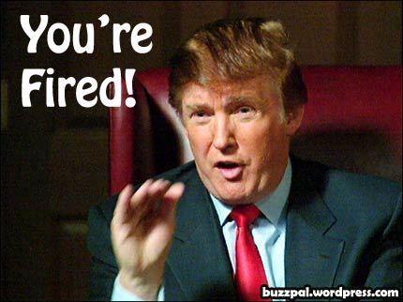
Events that IT/Ops subscribe to
HR – employee hired, employee fired
Provisions / De-provisions machines, accounts, etc

Slide 131
Referential Integrity & Reporting
Notes:
Updates, inserting orphans, deleting “parents”.
Business intelligence Service

Slide 132
Integration Endpoints ( + email )
IT/Ops
DataExporter message handler
IProvideCustomerInfo
IProvideBillingInfo
IProvideProductInfo
Customer Care
Billing
Product Catalog

Slide 133
Break

Slide 134
Service Decomposition
The large-scale business capability that a service provides can be further broken down
“Business Components” refer to the technical elements that implement the capability’s constituent parts

Slide 135
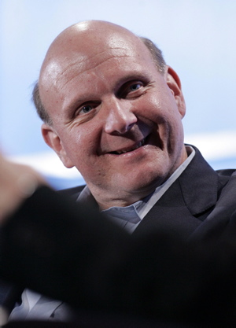
Quality of Service Requirements
Sales
Order 10 Products
Order 10 Million Products

Slide 136
Business Components
Sales
Order 10
Products
Regular Customers
Order 10 Million Products
Strategic Customers

Slide 137
More Examples
Airlines
Different counters for business class customers
Shipping
Need to track temperatures for frozen goods / meat
Can use regular trucks for toilet paper
Billing
Monthly invoicing for customers with an agreement
Others billed directly to credit card

Slide 138
Business Components & Pub/Sub
Fulfillment
Billing
Regular Products
Subscribe to Order Billed
Order Billed
Perishable Products
Subscribe to Order Billed

Slide 139
Services and transactions
But some kinds of messages don’t change service state
And other kinds of messages can get lost in case of failure (volatile data like stock quotes)
We can divide a Business Component along transactional lines for improved performance, into “Autonomous Components”
Transactions stay within the boundary of a component

Slide 140
Autonomous Components
A Business Component is composed of one or more Autonomous Components
An Autonomous Component is responsible for one or more message types
Composed of one or more message handlers and the rest of the layers in the service
Is independently deployable, has its own endpoint

Slide 141
Autonomous Component Makeup
Schema
Message
Type
Bus
Message
Handler
Common
Service
Layers
endpoint

Slide 142
Bus-Handler interaction
Tx
Scope

Slide 143
AC’s , BC’s, and Services
Service
AC
DB
AC
BC
AC
DB
AC
BC

Slide 144
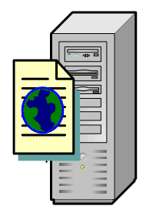
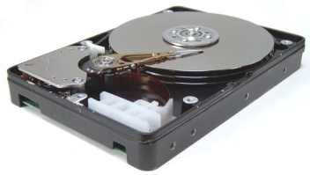
Shades of Autonomy
AC
DB
Msg
End
Point
Storage
Shared
Shared
Shared
Shared
Shared
Own
Shared
Own
Own
Own
Own
Own

Slide 145

SOA = Business Value
Order
Order Processing
Strategic Customers
Notes:
IT spending tied to messages in a specific business context
Recap.

Slide 146
Summary
Autonomous Components are the unit of deployment in SOA
An AC takes responsibility for a specific set of message types in the service (ideally 1).
An AC uses the bus to communicate with other ACs.

Slide 147
Service Structure
Command/Query Responsibility Segregation
Udi Dahan – The Software Simplist
Enterprise Development Expert & SOA Specialist
Consulting, Mentoring, & Training
Helping you Keep It Simple
www.UdiDahan.com
email@UdiDahan.com

Slide 148
AC’s , BC’s, and Services
Service
AC
DB
AC
BC
AC
DB
AC
BC

Slide 149

Multi-User Collaboration
Need to assume users are looking at stale data
Get data
Get data
User is looking at stale data
Change data

Slide 150
Caching introduced for performance
UI
BL
DAL
Facade
Cache
DB
Notes:
If the result is that users are going to be seeing stale data anyway – why go all the way to the database?
And if we’re going to be putting a cache in there anyway – we’re practically ensuring staleness, we just don’t tell anybody, right?

Slide 151

Why transform between tiers?
Keeping the cache up to date is even more work
Cache
UI
WS
DB
Map from DTOs & WS to view model
Map from DTOs and WS to domain objects
Use ORM to map from tables to domain objects
Notes:
That’s a lot of transformation!

Slide 152
Queries
?

Slide 153
Be up front about query staleness
List of customers
Data correct as of 10 minutes ago
Notes:
We see this on Twitter and Facebook – telling us how long ago something happened

Slide 154
Keep queries simple
2 Layers == 2 Tiers
UI
Query only
Persistent View Model
For each view in the UI,
have a view/table in the DB
SELECT * FROM MyTable (WHERE ID = @ID)
Notes:
They’re tightly coupled anyway – sticking a bunch of layers in between won’t change that.
This can be as simple as statically defined views on top of your tables.
For security, you can define SELECT permissions on those views.

Slide 155
Data Duplicated, No Relationships, Data Pre-Calculated
Customer Service Rep view
Supervisor view
List of customers
List of customers
ID Name Phone
ID Name Phone Lifetime value
Rep_Customers_Table
ID | Name | Phone
Supervisor_Customers_Table
ID | Name | Phone | Lifetime Value

Slide 156
No relations between views / tables
No coupling between screens in the UI
No foreign keys between tables in the persistent view model

Slide 157
Data duplication in views & tables
The same information can be shown on different screens in the UI
The same information can be stored in different tables in the persistent view model
Tables contain a column for every piece of information shown in the UI
Avoid calculations when doing queries
Have the data calculated ahead of time

Slide 158
Deployment and Security
Deploy the persistent view model DB to the web tier (only SELECT is permitted)
Don’t have to go through the firewall – faster
Role-based security
Different screens for different roles go to different tables – SELECT permissions per role
Just as secure as in-memory caches
If not more so

Slide 159
Use for preliminary validation
Before going to submit data, check if it already exists in the persistent view model
Uniqueness
Can expose to user (Yahoo user signup)
Related Entity Existence
Address validation – existence of street name
Results in less commands being rejected

Slide 160
Commands
!

Slide 161
Validation and Business Rules
Validation: Is the input potentially good?
Structured correctly?
Ranges, lengths, etc
Rules: Should we do this?
Based on current system state
What the user saw is irrelevant
Notes:
Sometimes developers mix up these two, but they’re different – first we validate the command, AFTER that, we perform rules, AFTER that we store/update data.

Slide 162
Command Processing Layers
Input from User
Rules
Persistence
Validation
DB

Slide 163
Command Processing Tiers
Transaction
Get current state
Command
Input
WS
DB
Persist
Validation
Validation
Rules
Notes:
But what kind of rules will we need? The kind that answer the following question…

Slide 164
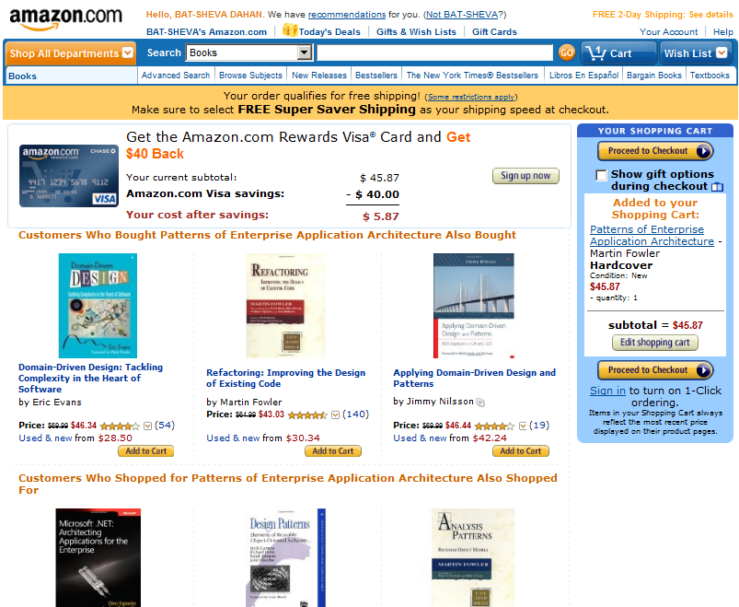
Amazon.com “add to shopping cart”
Shopping cart not actually shown!
Item added shown (from cmd)

Slide 165
Should we do what the user asked?
Orders
ID | Total | Date | Shipped | Account | etc | etc | etc
317 | $37.87 | 1/9/09 | Yes | A17T5
318 | $99.99 | 3/7/09 | Yes | A17T5
319 | $100.11 | 4/8/09 | Yes | P313Z
320 | $69.47 | 9/9/09 | No | P599Z
Save
Cancel
Notes:
These kinds of screens are often described as CRUD – for create, read, update, and delete in the developer lingo
Also known in the user lingo as CRAP.

Slide 166
Capturing user intent
Why is it important? Differentiating between:
Ship to a different address
The user moved (upscale neighborhood)
Show them different ads
Sometimes users accidentally modify fields when tabbing between columns
Notes:
The user who can change a shipping address for an order may not be permitted to change the user’s address.
By automatically shoving all data into the same grid without thinking through these rules, we make it harder on ourselves to later implement these rules.

Slide 167
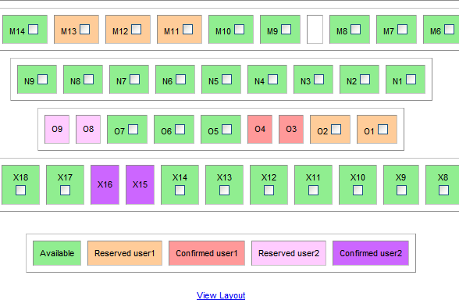
Reservation systems
Notes:
I’m using this image because it’s small enough to understand what’s going on – to see the detail of what’s available, reserved, confirmed, etc.
Now imagine larger scales…

Slide 168
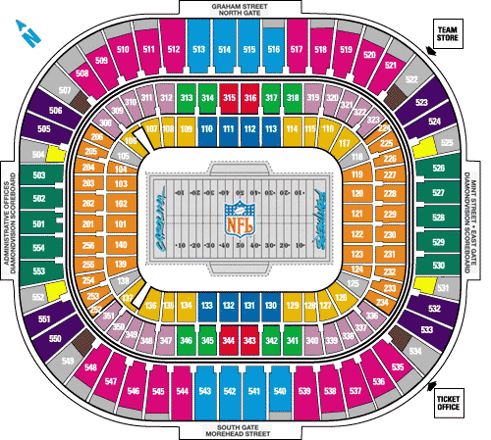
Reservation systems
Notes:
Each one of the slots here is a block of seats – not just one.

Slide 169
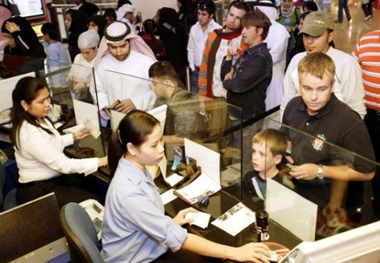
UI Is Result Of Single User Thinking
Customers line up at ticket counters
Line provides fairness
Line is invisible on the internet – we can be “unfair”

Slide 170
Not capturing user intent
In a traditional UI – the checkbox
Why do users select multiple seats?
Because they’re reserving for a family / friends
But then, concurrency happens
Somebody else got in first on one of the seats
Try to find a block of seats somewhere else

Slide 171
Capturing user intent
Group reservation:
Small group – sitting together
Large group – several small groups
Enter number of people
Enter preferred seat type – indicates cost
Emails back when reservation can be filled
Include waiting list functionality

Slide 172
User population partitioning
VIP customers – first window of time
Want the best seats in the house
Willing to pay extra for the privilege
Groups – next window of time
Want to sit together
Everybody else – last window of time
Will take any free seat

Slide 173
Scalability benefits
Thousands of seats, hundreds of thousands of requests
No need to show actual status

Slide 174
What is a good command?
The kind you can reply with:
“Thank you.
Your confirmation email will arrive shortly”
Inherently asynchronous
Not really related to an entity

Slide 175
Commands versus Entities
It’s easier to validate the command
Less data
More specific
Is this potentially good
Validating large entities is complex

Slide 176
CQRS in action
Data from input immediately overlaid on queries
Queries
View Model
UI
Queries
View Model
Updater
Commands
Publish
Input
WS
Validation
Rules
DB
Notes:
This way, reads and writes don’t interfere with each other in the DB

Slide 177
Writes internal, Publish external
User activity happens within the context of a service
Inherent coupling between client and server
Publishing an event suitable for internal and external consumers

Slide 178
Schema – Internal
Internal schema
Message types are Commands:
ChangeCustomerAddress
Faults:
CustomerNotFound, None/Success

Slide 179
Schema - External
Primarily based on events:
CustomerBecamePreferred
OrderCancelled
Past tense
Something that has already occurred
Stay away from DB thinking – no CRUD
Think about business status changes

Slide 180
Faults
For all intents and purposes, an Enum
CustomerNotFound
OrderLimitExceededForCustomer
NOT AN EXCEPTION!
We expect these things to occur
Also, exceptions don’t really work in asynchronous programming

Slide 181
Schema Packaging
Everything in its own package
Commands – Internal
Faults – Internal
Events - External
Initiators of a command will not want to depend on the schema, but will need to handle faults.

Slide 182
Client Structure
Views
Service Agents
Controllers
Initiate the sending of messages
Need to handle faults
Send messages
Don’t handle faults

Slide 183
Message Handlers
Interpret the intent of the message into calls on the domain model & persistence infrastructure
Should not contain complex business logic – that belongs in the domain model

Slide 184
Summary
Think of reads and writes differently
Reflect that difference in the schemas
Design commands so that they almost can’t fail

Slide 185
Scalability and Flexibility
Udi Dahan – The Software Simplist
Enterprise Development Expert & SOA Specialist
Consulting, Mentoring, & Training
Helping you Keep It Simple
www.UdiDahan.com
email@UdiDahan.com

Slide 186
Flexibility in deployment
Any number of autonomous components (ACs) can be deployed to a single machine
Or even a single process
Or have a single AC deployed on each machine

Slide 187
Scalability
Since each autonomous component maintains its state in the database of its business component
We can have a number of servers each running an instance of the same autonomous component
Implementation of the “Competing Consumer” pattern

Slide 188
Scaling out an AC
Autonomous Component
Distributor
ACI
Ready
Autonomous Component Instance
on each machine
ACI
ACI

Slide 189
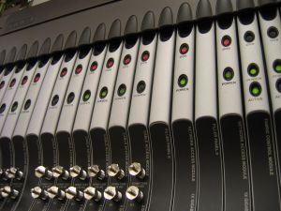
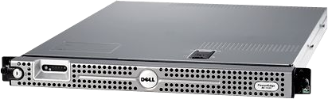
Heterogeneous Server Farms
Pull
Pull
Pull
Pull

Slide 190
Fault Tolerance
Any number of active backups
Automatic load balancing

Slide 191
Monitoring
Visibility in to the number of requests pending
Number of messages in the distributor’s queue
Quickly zoom in on which autonomous component is a bottleneck.

Slide 192
Runtime Scale-Out
Addition of more servers of the same autonomous component is “plug & play”
No need to take down the system

Slide 193
Versioning
Run multiple versions of the same autonomous component side-by-side
Clients not bound to a specific server implementation by a proxy
Easy to swap out autonomous component implementation without affecting clients

Slide 194
Summary
Configuration of autonomous components enables rich system capabilities
Flexibility
Scalability
Monitoring
Versioning

Slide 195

Long Running Processes
Udi Dahan – The Software Simplist
Enterprise Development Expert & SOA Specialist
Consulting, Mentoring, & Training
Helping you Keep It Simple
www.UdiDahan.com
email@UdiDahan.com

Slide 196
What is “process”?
A process can be described as a set of activities that are performed in a certain sequence as a result of internal and external triggers.
The most basic process control is: if-then
More complex processes include state machines

Slide 197
What is “long running process”?
A long running process is a process whose execution lifetime exceeds the time to process a single external event or message.
Long running means that multiple external events/triggers are handled by the same process instance – is Stateful
Derived from “long-lived transactions” work in the late 80’s and early 90’s

Slide 198
Why use long running process?
Long running processes provide a state management facility that enables a system to encapsulate the logic and data for handling an external stream of events.
It’s just good OO programming.

Slide 199
Long running process example
Process
Send requests to 3 other services
Request
Save requests state
Store
Notes:
1 min

Slide 200
Long running process example
Process
Send requests to 3 other services
Request
Save requests state
Response 2
Update state
Store
Check if done
Notes:
1 min

Slide 201
Long running process example
Process
Send requests to 3 other services
Request
Save requests state
Response 2
Update state
Store
Check if done
Other Request
Notes:
1 min

Slide 202
Long running process example
Process
Send requests to 3 other services
Request
Save requests state
Response 2
Update state
Store
Check if done
Other Request
Response 3
Update state
Check if done
Notes:
1 min

Slide 203
Long running process example
Process
Send requests to 3 other services
Request
Save requests state
Response 2
Update state
Store
Check if done
Other Request
Response 3
Update state
Check if done
Other Request
Notes:
1 min

Slide 204
Long running process example
Process
Queue
Send requests to 3 other services
Request
Save requests state
Response 2
Update state
Store
Check if done
Other Request
Response 3
Update state
Check if done
Other Request
Response 1
Update state + resolve
Done! Build Response
Enqueue Response
Notes:
1 min

Slide 205
Sagas
Triggers are messages
Similar to message handlers
Can handle a number of different message types
Different from message handlers
Have state, message handlers don’t

Slide 206
Bus
Create Saga For Message
Start Saga Message
Saga
Dispatch Message
Send Saga Messages
Saga Persister
Save Saga
DB
Persist

Slide 207
Saga Message
Bus
Get Saga by Message.SagaId
Saga Persister
4.Return Saga
Dispatch Message
Saga
2.New
3.Fill
Complete
Saga Complete
Timeouts are regular messages
1.Get
Delete
Can occur on multiple machines concurrently
DB

Slide 208
The hard part
The easy part is using the building blocks
The hard part is analyzing the business processes to identify what the steps should be.
When interacting with legacy systems, each response becomes a message which triggers an activity.
Legacy systems are usually internal to a service

Slide 209
Workflow & Orchestration
Orchestrating legacy systems within a service is one of the primary uses of sagas
Using sagas within a new service to orchestrate existing services is usually the result of new business processes
Orchestration is not a service by itself.

Slide 210
Summary
Use messaging building blocks to support long running processes.
Orchestration = long running processes
Keep workflows/orchestrations within services

Slide 211
Service Layer - Domain Model Interactions
Udi Dahan – The Software Simplist
Enterprise Development Expert & SOA Specialist
Consulting, Mentoring, & Training
Helping you Keep It Simple
www.UdiDahan.com
email@UdiDahan.com

Slide 212
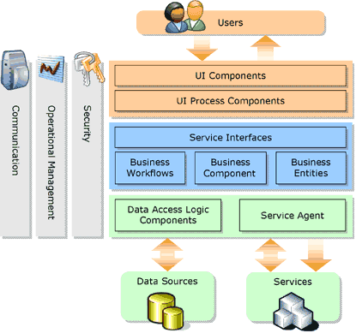
What most architecture looks like today

Slide 213
But where do business rules go?
Here?
Here?
Here?
Here?
Here?
Here?

Slide 214
No real reuse between tiers

Slide 215

The book that changed everything
… and the pattern that battles complexity…

Slide 216
The Domain Model Pattern
Properties
Methods
Events

Slide 217
When to use it, when not to
“If you have complicated and everchanging business rules…”
“If you have simple not-null checks and a couple of sums to calculate, a Transaction Script is a better bet”
p119 Patterns of Enterprise Application Architecture

Slide 218
Independent of all concerns
UI
DB
Communications

Slide 219
Domain Models are made of “Plain old .NET objects”
public class Product
{
// properties
// methods
}
public class Customer
{
// properties
// methods
}
public class OrderLine
{
// properties
// methods
}
public class Order
{
// properties
// methods
}

Slide 220
Highly testable
Test
Register for events
Call a method
Check properties & event args

Slide 221
Unit Test Sample
[TestMethod]
public void CreateOrderShouldConnectToCustomer()
{
Customer c = new Customer();
Order o = c.CreateOrder();
Assert.AreEqual(c, o.Customer);
}

Slide 222
Unit Testing Complex Logic
[TestMethod]
public void DiscountingAnOrderForBadCustomerShouldFail()
{
Customer c = new Customer();
Order o = c.CreateOrder(1000);
c.MarkDelinquent();
bool discounted = true;
o.CouldNotDiscount += delegate { discounted = false; };
o.DiscountBy(0.05);
Assert.IsFalse(discounted);
Assert.AreEquant(1000, o.Total);
}

Slide 223
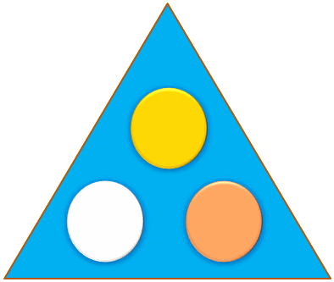




Can be deployed Multi-Tier it’s just a bunch of DLLs – or even just one
DB
SQL CLR

Slide 224
Persisting Domain Models
?
But who’s in charge
Object
Relational
Mapping
DB

Slide 225
Service Layer manages persistence
Service Layer
Object
Relational
Mapping
Manages connections
and transactions
DB

Slide 226


Concurrency Models
Optimistic
Realistic
Pessimistic

Slide 227
Multi-table Spanning Transactions
Tx 1
Tx 2
x
x
x
x
Transactions can get an inconsistent picture!

Slide 228

Realistic Concurrency
Need to get a current set of data
before changing anything
Get Domain Object
Ask it to update itself
Domain Object runs business rules
If successful, updates its own state

Slide 229
Service Layer sample code
public void Handle(MakeCustomerPreferredMsg m)
{
Customer c = s.Get<Customer>(m.CustomerId);
c.MakePreferred();
}
Necessary to address concurrency

Slide 230
Domain Model sample : Customer
public void MakePreferred()
{
foreach(Order o in this.UnshippedOrders)
foreach(Orderline ol in o.OrderLines)
ol.Discount(10.Percent);
}
Entity relationships expose us to possible inconsistency!

Slide 231


Realistic Concurrency
Some changes can be concurrent, others can’t (?)
You change the customer’s address
I update the customer’s credit history
You cancel an order
I try to ship the order
Race condition

Slide 232
Even if they’re easy to implement
public class Order
{
public void Cancel()
{
if (status != OrderStatusEnum.Shipped)
//cancel
}
public void Ship()
{
if (status != OrderStatusEnum.Cancelled)
//ship
}
}

Slide 233
Remember
In CQRS, commands don’t fail
Race conditions don’t exist in business
A microsecond either way shouldn’t change business objectives

Slide 234
Find underlying business objectives
Rules:
Cannot cancel shipped orders
Because shipping costs money
That money would be lost if the customer cancelled
Because we refund the customers money
Don’t ship cancelled orders
Why?
So?
Why?
Refund Policies

Slide 235
Analyze
When an order is cancelled,
does the refund need to be given
immediately?
Can we give a partial refund?
No
Yes

Slide 236
Dig Deeper
What does a customer have to do
in order to get a refund?
Return the products
Most orders cancelled soon after they were made

Slide 237
Consider Service Boundaries
Cancel Order
Ship Products
Products Returned
Refund Policy
Sales
Shipping
Billing
Which services require a domain model?
Refund policy driven by multiple messages

Slide 238
Domain Models ARE Sagas

Slide 239
Web Services & User Interfaces
Udi Dahan – The Software Simplist
Enterprise Development Expert & SOA Specialist
Consulting, Mentoring, & Training
Helping you Keep It Simple
www.UdiDahan.com
email@UdiDahan.com

Slide 240
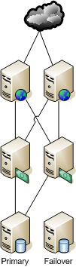
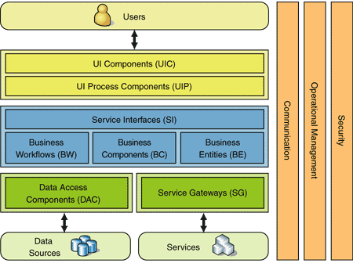
Common Web Architecture

Slide 241
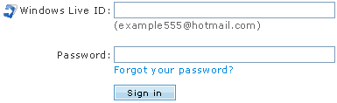
Synchronous User Login

Slide 242
Scaling Out the Web Tier
DB
Just shows that the DB is the bottleneck

Slide 243
Caching – In Process
Keeping the cache up to date across farms is challenging

Slide 244
Cache Invalidation
In the DB, reads interfere
with writes – hurts performance

Slide 245
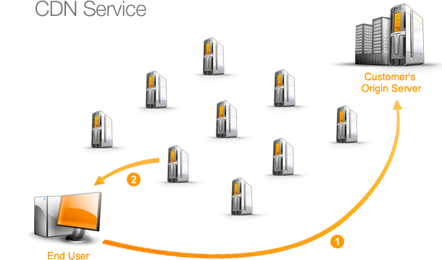
Content Delivery Networks
Great for off-loading static content
IMG
JS
CSS

Slide 246
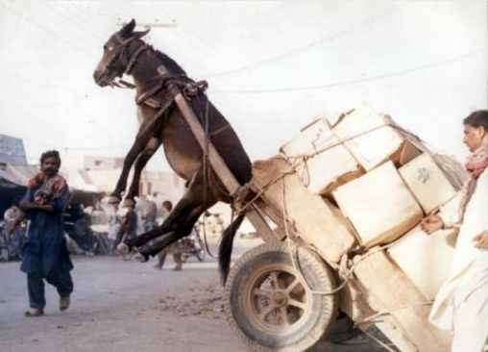
Almost there…

Slide 247
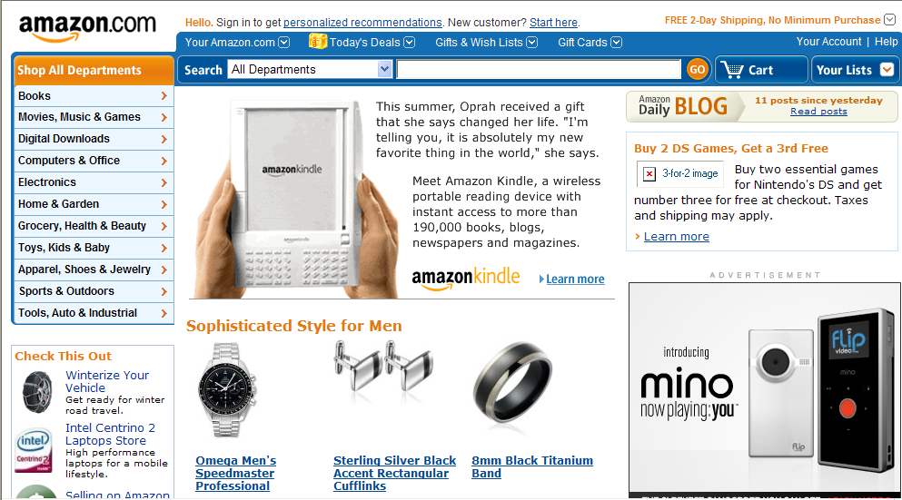
Amazon.com
It’s all dynamic
It’s all static

Slide 248
The static dynamic web
* Amazon doesn’t actually work like this
Layout.CSS
Layout.JS
Dept.XML
Kindle.XML
Dept.CSS
Kindle.CSS
Notes:
Apache mod_expires, mod_headers

Slide 249

What happens over the web?
Cached by browser
Layout.CSS
Layout.JS
Cached by ISP
Dept.XML
Dept.CSS
Cached by CDN
Kindle.XML
Kindle.CSS

Slide 250
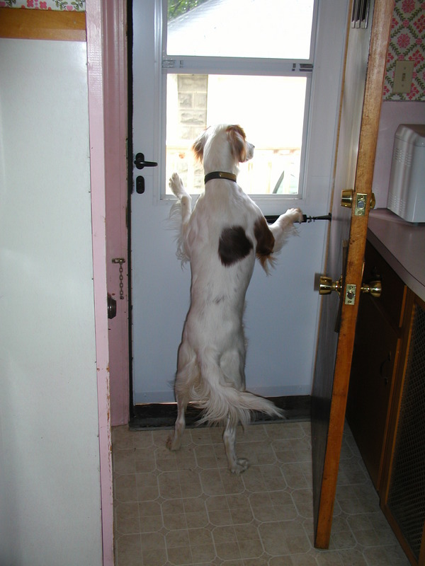
Nobody even comes knocking

Slide 251
Web-based UI Service Composition

Slide 252
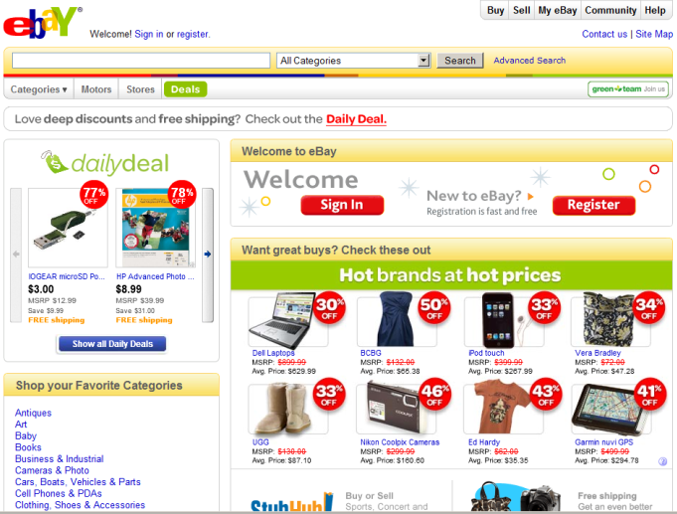
Browser-Side Composition
Each URI handled by a different service
Layout.CSS
Layout.JS
<link rel=“/welcome/”>
<link rel=“/dailydeal/”>
<link rel=“/hotbrands/”>
<link rel=“/categories/”>

Slide 253
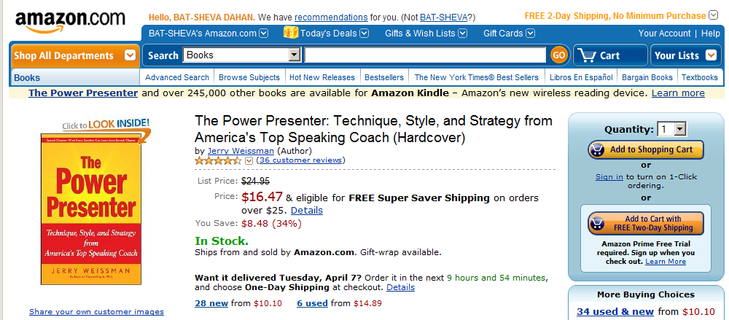
Server-Side Composition (SEO friendly)
HTTP Processing Pipeline
ASP.NET Modules
Builds a single response
Layout
<div id=“Layout.Top”>
Product Catalog
<div id=“Catalog.Name”>
Price
<div id=“Pricing.Price”>
Inventory
<div id=“Inventory.InStock”>

Slide 254

Personalization
Don’t underestimate the power of cookies
The weather widget
Look up location based on IP address
Look up weather based on location
Stock portfolio GOOG 500
MSFT 350
-------------------------
Total $$$

Slide 255
In-Process Always Updated Solution
Login
Update cache
Register User
Publish new user data
DB

Slide 256
Messaging
Register User
Publish new user data
RegisterUserMessage
UserAddedMessage

Slide 257
Messaging
UserAddedMessage
RegisterUserMessage
UserAddedMsg : IMessage
RegisterUserMsg : IMessage
Username : string
HashedPassword : string
Username : string
HashedPassword : string

Slide 258
Web Server Startup Logic
Subscribe for Notifications
Request All Users
Start listening for messages

Slide 259
Web Server Startup Logic
public class Global : HttpApplication
{
protected void Application_Start(...)
{
IBus bus = builder.Build<IBus>();
bus.Start();
bus.Subscribe(typeof(User_Added_Message));
bus.Send(new Get_All_Users_Message());
}
}

Slide 260
Web Server Registration Logic
Register_OnClick
Hash Password
Create Message
Send to Service

Slide 261
Web Server Logic
public class UserController
{
public void Register(string uName, string pwd)
{
string hashedPwd = this.Hash(pwd);
RegisterUserMsg m = new RegisterUserMsg();
m.Username = uName;
m.HashedPassword = hashedPwd;
this.Bus.Send(m);
}
}

Slide 262
Service Message Handling Logic
Message Received
Write to DB
Publish Message

Slide 263
Service Message Handling Logic
public class RegisterUserMsgHandler :
IMessageHandler<RegisterUserMsg>
{
public void Handle(RegisterUserMsg m)
{
using (/* DB stuff */)
{
// Insert into user table
this.Bus.Publish(new UserAddedMessage(
m.Username, m.HashedPassword));
// DB.Commit();
}
}
}

Slide 264
Web Server Message Handling Logic
Message Received
Update local cache

Slide 265
Web Server Message Handling Logic
public class UserAddedMsgHandler :
IMessageHandler<UserAddedMsg>
{
public void Handle(UserAddedMsg m)
{
Cache.SetPassword(
m.Username,
m.HashedPassword
);
}
}

Slide 266
Web Server Login Logic
Login_Click
Hash Password
Access local cache
Compare Passwords

Slide 267
Web Server Login Logic
public class UserLoginController
{
public bool Login(string uName, string pwd)
{
string hashedPwd = this.Hash(pwd);
string existingPwd = Cache.GetPassword(uName);
return hashedPwd == existingPwd;
}
}

Slide 268

Login Performance
One-Way Hash
sub microsecond
Cache Access
1M entries
Read Only
sub microsecond
Read Write
5 microseconds

Slide 269
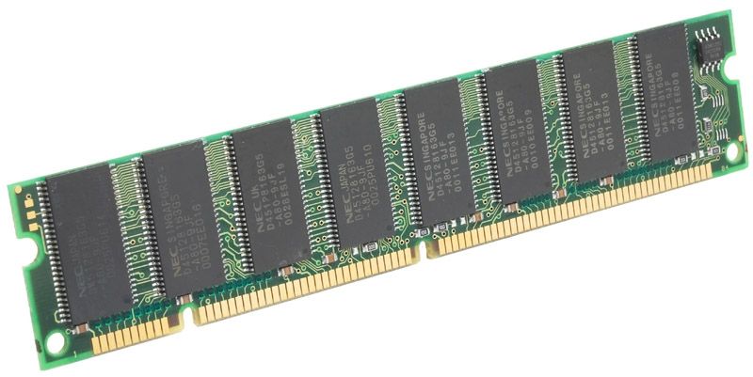
Web Server Memory Usage
Total | 32bit 64bit
User | 90 B 102 B
1M users | 90 MB 102 MB
2 GB
Average username: 12 characters (24 Bytes)
Hashed password : 512 bit (64 Bytes)
Overhead (32bit): ( 4 Bytes)
Overhead (64bit): (16 Bytes)

Slide 270
Confirmation Emails
Confirm
To prevent DOS attacks,
include a code in the email

Slide 271
User Registration Process
[StartsSaga]
Request Received
Confirmation Received
Send Email Confirmation
Return Success
Saga Id
ISagaMessage
Saga Id

Slide 272

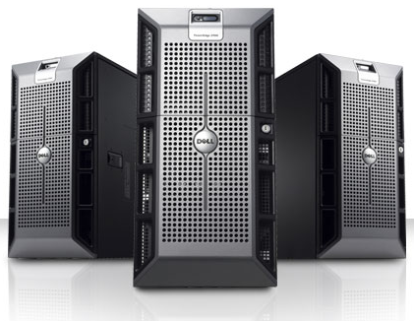
Cost Difference
N x $1K
DB
M x $10K
M > N
Notes:
But nothing is cheaper than the web.

Slide 273

Thank you
Udi Dahan – The Software Simplist
Enterprise Development Expert & SOA Specialist
www.UdiDahan.com

Slide 274
Smart Client Service Interactions
Udi Dahan – The Software Simplist
Enterprise Development Expert & SOA Specialist
Consulting, Mentoring, & Training
Helping you Keep It Simple
www.UdiDahan.com
email@UdiDahan.com

Slide 275

Smart Client Environments
Servers go up & down
Wifi goes in & out
Intermittent Connectivity

Slide 276
Smart Clients and Pub/Sub
Medication out of stock
Publish medication out of stock
Prescribe different medication
OK
Need to Support Pub/Sub & Request/Response

Slide 277

Occasionally Disconnected (Wifi)
Server
MSMQ
Outgoing Incoming
MSMQ
Outgoing Incoming
Store and
Client
Forward

Slide 278
Always ready for a “response”
Notifications work
the same way
Client
Thread
Thread

Slide 279
Dangers of Multi-Threading
Deadlocks
Difficult Debugging
Data Corruption

Slide 280



Simplistic Solution
Do everything on the UI thread
Client
Thread
Thread
I want to work now
When Wifi reconnects, sudden influx of messages may occur

Slide 281

Stable,
Thread-Safe
Solution

Slide 282
Single-threaded “Safe Haven”
Need to lock multiple objects
Views
Logic
Data
Comm

Slide 283

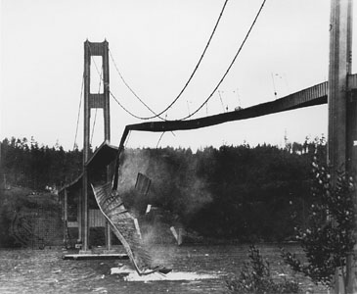

Multi-object locks
Do it yourself?
Hope you’re not building anything important
Microsoft already solved it for you with Synchronization Domains

Slide 284
Thread Synchronization
[Synchronization]
public class MySingleton : ContextBoundObject
{
}
Comes with significant overhead
Only use for singleton objects:
Applicative
Framework
Object Builder
Repository
Supervising Controllers

Slide 285



Incoming messages
Message Handlers
Bus
Repository

Slide 286
Message Handler Code
public class CustomersUpdatedMessageHandler :
IMessageHandler<CustomersUpdatedMessage>
{
public void Handle(CustomersUpdatedMessage message)
{
foreach(CustomerInfo info in message.Customers)
rep.Save(Convert.To<Customer>(info));
}
private IRepository rep;
public IRepository Repository { set { rep = value; } }
}

Slide 287
Message Handler Creation/Dispatch
JoinSynchronizationDomain = true;
Object Builder
BuildAndDispatch(
CustomerUpdatedMessageHandler,
Msg
);
CustomerUpdatedMessage
New
Handle
CustomerUpdated MessageHandler
Bus

Slide 288
Impact of Message Contracts
One message, lots of data
Data
Views
Message Handlers
Bus
1 Million Customers

Slide 289
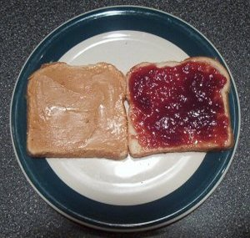
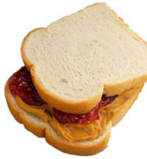
Spread data over many messages
But can be physically packaged together

Slide 290
Enough data per logical message
N
XML
Customers Updated Message
M
Customer Info
M ≅ 100 gives good user interactivity

Slide 291
Impact of Message Contracts
XML
More, smaller messages
Views
Data
Handlers
100
Bus
100

Slide 292
Server Side Code
public void Handle(GetCustomersMessage message)
{
// get customers from DB
int BATCH = 100;
int length = customers.Length / BATCH;
IMessage[] response = new CustomersUpdatedMessage[length]();
CustomersUpdatedMessage msg;
for (int i=0; i < customers.Length; i++)
{
if (i % BATCH == 0) msg = new CustomersUpdatedMessage();
m[i / BATCH] = msg;
msg.Infos.Add(Convert.To<CustomerInfo>(customers[i]);
}
bus.Reply(response);
}

Slide 293

Notifications and Smart Clients
Udi Dahan – The Software Simplist
Enterprise Development Expert & SOA Specialist
Consulting, Mentoring, & Training
Helping you Keep It Simple
www.UdiDahan.com
email@UdiDahan.com

Slide 294
Incoming messages
Message Handlers
Bus
?
Entity Updated
Repository

Slide 295
Supervising Controllers
Controller A
Subscribe to A updates
Controller B
Subscribe to B updates
Repository

Slide 296
Supervising Controllers
Controller A
A updated
Controller B
B updated
Update A
Message Handlers
Repository
Update B

Slide 297
Supervising Controller Code
public class ControllerA : BaseController
{
private IRepository rep;
public IRepository Repository
{
set {
rep = value;
rep.SubscribeToChangesForEntitiesOfType(
typeof(A),
RepositoryChangedForA
);
}
}
private void RepositoryChangedForA(IEntity entity, bool deleted)
{
A myA = entity as A;
if (myA == null) return;
// do something with myA
}
}
Can’t use generics when inheriting CBO

Slide 298
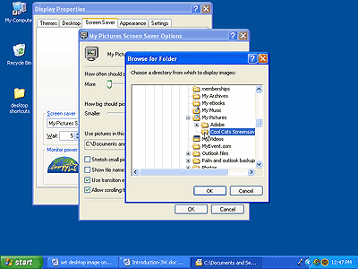
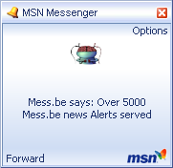
Pop-up “Toasts” for Notifications

Slide 299
Opening Views at Runtime
public class ControllerA : BaseController
{
private IBuilder builder;
public IBuilder Builder { set { builder = value; } }
private void RepositoryChangedForA(IEntity entity, bool deleted)
{
base.MarshalToUiThread(new RepositoryChangedDelegate(ChangedA),
entity, deleted);
}
private void ChangedA(IEntity entity, bool deleted)
{
A myA = entity as A;
if (myA == null) return;
IViewA viewA = this.builder.Build<IViewA>();
viewA.Entity = myA;
viewA.Show();
}
}

Slide 300
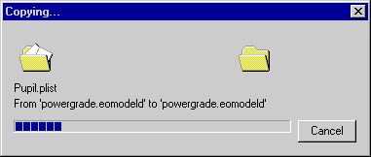
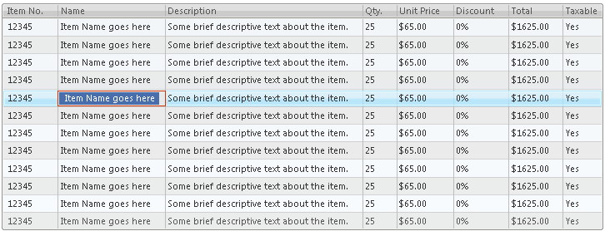
Notifications Update Existing Views
Progress bars
Dynamic Filters
Add new or updated item that now matches filter
Deleted items removed or flagged

Slide 301
Client-Side Domain Model - Why?
Messages
Loose Coupling
Server
Client
Converter
Converter

Slide 302
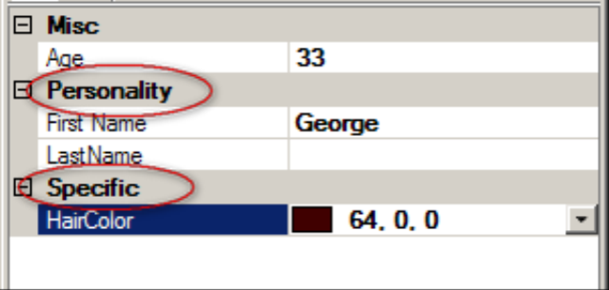
Domain Models
Design for ease of use with UI
Include validation logic

Slide 303
Domain Model Threading Concerns
Client
Thread
Thread
Views
Don’t share instances
Logic
Set Total
Set Currency
Set Total
Set Currency
Order 123
Total Currency

Slide 304
No Shared Data Instances
Views
Logic
view.Entity = clone;
clone = d.Clone();
Data
More online
Notes:
http://udidahan.weblogs.us/2007/12/07/eureka-aop-is-the-final-piece-of-the-multi-threaded-smart-client-puzzle/

Slide 305

Cloning-Proxies for Views
Just so you don’t forget to clone, accidentally making the system non-thread safe
Proxy
Logic
view.Entity = data
Clones parameters to methods and setter values implementing IEntity
view.Entity = clone
clone = d.Clone();
Data
Views

Slide 306
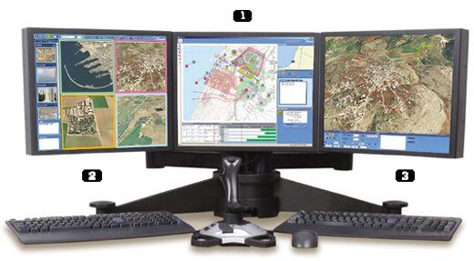
Map Display
Updating in “real time”

Slide 307
Map Display - Challenges
May receive 100’s of updates per second at peak
GUI can’t update that fast
Can update symbol objects in real time
Draw symbols at most 1-2 times per second

Slide 308
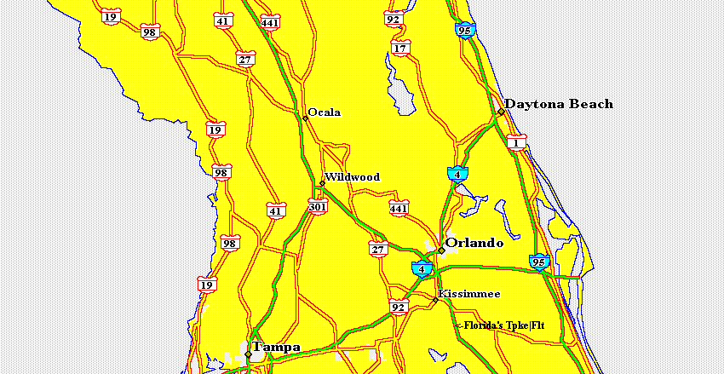
Map Display - More Challenges
Drawing dependent objects
Q
326 MPH
E1045
OK
3K ft
Q
487 MPH
FA73
OK
10K ft
59 Mi
300 ft/s
Draw a consistent snapshot in time
to prevent “staggering”

Slide 309
Map Controller Behavior
1-2 times / sec
MapController
Timer
Draw
Build symbols
CloneAll();
Q
Repository

Slide 310
Offline Enabled
Client
Thread
Thread
DB /
File
Server
ForwardReceivedMessagesTo

Slide 311
Synchronization Conflicts
Extended periods of disconnected work
Client DB has diverged from Server
Successful local messages may fail on sync
Keep semantic dependencies in mind

